Slide 1
Foundations of Data Science
Final Presentation
Joe Marco

Slide 2
Backorders, the BILLION dollar issue
Project Approach:
Executive Overview
The Plan
The Data
Data Wrangling
Statistics, trends, probability, & visual analysis
Machine Learning and Predictions
Conclusions and Recommendations

Slide 3
Disclaimer
This completed capstone report is intended for interpretation for business members, not s much for data scientists. As such the level of detail in terms of the methods applied and code specifics will be interpreted at a high level. The capstone report was a project wrapup from the author (Joe Marco), who had limited R & data science knowledge prior to this initiative.

Slide 4
Executive Overview
The all too frequent feeling of searching for hours online for the perfect item, only to click the "add to cart" option or order button, to find out the product is on "backorder". Sometimes we do not even have this option when searching in a retail store, if a product is sold out, we simply move on 9 times out of 10. But what exactly is backorder?
Stock-outs cause a projected $25 billion in losses for individual businesses every year. To a struggling business, simply being out of merchandise doesn’t just put an immediate dent in finances, it can also mean adverse long-term impact such as loss of market share due to customer dissatisfaction, loss of patronage, and negative word-of-mouth.
The Goal: With this capstone report, I will be attempting to show you exactly the steps you can take (from a data point of view) to evaluate your supply chain information (inventory, lead time, sales predictions, etc.) and build predictive models that show how AT RISK your company may be for product backorder issues, ultimately contributing to a negative impact on your business.

Slide 5
The Plan
What can I predict based of a reference data set?
What can I measure based off my output?
What actions should be taken by a business based off my output?
We will attempt to predict back orders based off historical data
We will Utilize key pieces of data like inventory levels and lead time to analyze predictions of backorders
We will focus on products that have sales in recent months, and have a high consumer need so that are model is optimized for "in demand products"

Slide 6
The Data
I will be leveraging existing product backorder data that highlights a variety of information around products, and will usually exist in business systems. A snapshot of the data can be seen below. For information refer to references.
1,000,000 + Rows of product supply chain information
Limitations:
We do not have dollar sales figures, meaning no way to guage potential impact of revenue/profit based off backorder issues
We do not have “Source (supplier)” information to be able to determine which suppliers by name are contributing to backorder issues, although we could likely find some commonalities to assume which skus come from the same source

Slide 7
The Data (definitions)
sku - Random ID for the product
national_inv - Current inventory level for the part
lead_time - Transit time for product (if available)
forecast_3_in_transit_qty - Amount of product in transit from source
month - Forecast sales for the next 3 months
forecast_6_month - Forecast sales for the next 6 months
forecast_9_month - Forecast sales for the next 9 months
sales_1_month - Sales quantity for the prior 1 month time period
sales_3_month - Sales quantity for the prior 3 month time period
sales_6_month - Sales quantity for the prior 6 month time period
sales_9_month - Sales quantity for the prior 9 month time period
min_bank - Minimum recommend amount to stock
potential_issue - Source issue for part identified
pieces_past_due - Parts overdue from source
perf_6_month_avg - Source performance for prior 6 month period
perf_12_month_avg - Source performance for prior 12 month period
local_bo_qty - Amount of stock orders overdue
deck_risk - Part risk flag
oe_constraint - Part risk flag
ppap_risk - Part risk flag
stop_auto_buy - Part risk flag
rev_stop - Part risk flag
went_on_backorder - Product actually went on backorder. This is the target value.

Slide 8
Data Wrangling
Read in the data
Rename fields to common ontologies
Check for null values in data
Replace null values
Confirmation of cleansed data
Saved output of cleansed data
*** Refer to Capstone report for specifics on above process

Slide 9
Statistics, trends, probability, & visual analysis
Unique Counting
Focus on backordered products
Calculate Averages
Calculate Probability
Analyze trends
Visualize data & trends
*** Refer to Capstone report for specifics on above process & visualizations

Slide 10
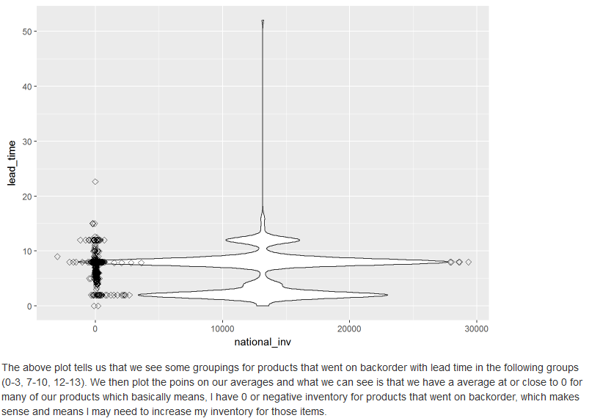
Statistics, trends, probability, & visual analysis

Slide 11
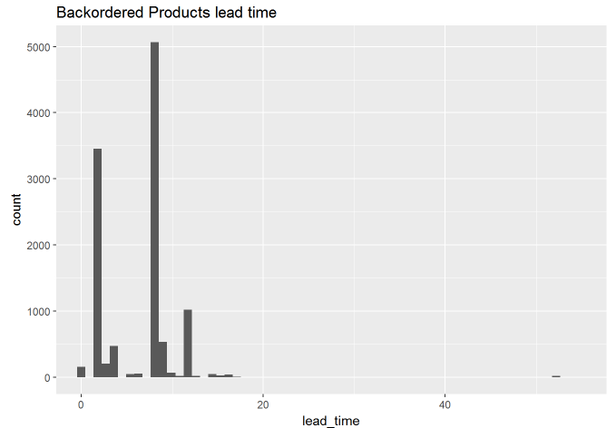
Statistics, trends, probability, & visual analysis

Slide 12
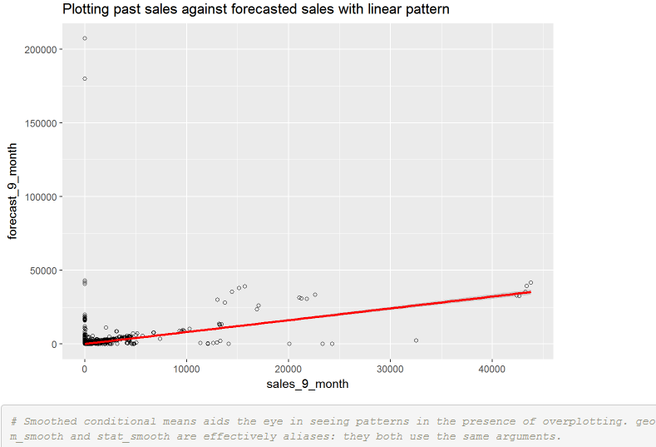
Statistics, trends, probability, & visual analysis

Slide 13
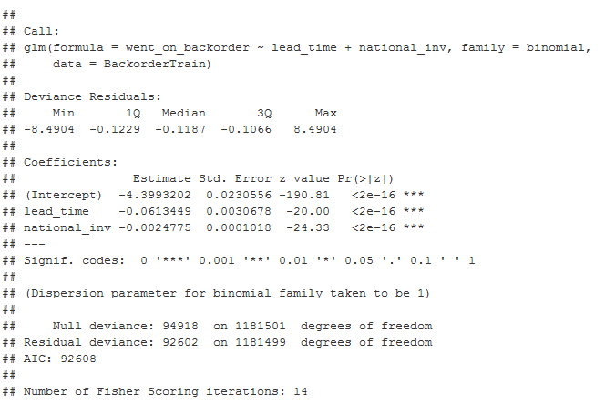
Machine Learning and Predictions

Slide 14
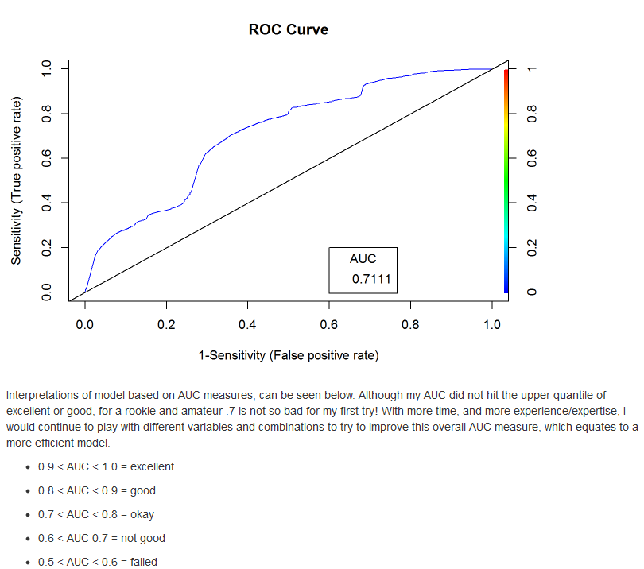
Machine Learning and Predictions

Slide 15
Conclusions and Recommendations
Logistic Regression
Build a model
Model Assessment
Model Measure (ROC curve)
Apply out of sample metrics

Slide 16
Conclusions and Recommendations
A trained model can accurately identify likelihood of product backorders based off inventory levels and lead time.
In practice, the probabilities returned from the logistic regression model can be used to prioritize how “AT RISK” your supply chain pipeline could be due to lead time & inventory issues.
This model can be used to feed another out of sample set of data, from any big business, in which we stated a list of products, their lead time to delivery, and their inventory to get some rough predictions on likelihood of backorders.
We can assume that if our predicted true backorders were a larger number, then we would have an issue that we could act on and increase/replenish inventory, or look into product transport and see how we can cut down lead time.

Slide 17
Where do we go from here?
The best recommendation I could give off the analysis and interpretations we have done is to place heavy focus on inventory and lead time around your product data. Using existing models and those outlined in this project, we can continuously measure our business performance.
Let’s keep in mind a very important concept. DATA SCIENCE and MACHINE LEARNING are not a foolproof solution. Any initiatives around Machine learning and data science should ALWAYS be cross verified with other solutions to ensure proper business decisions.

